Slide 1

Tribhuvan University Faculty of Humanities and Social Sciences
“BCA Notes Hub”
A Project Report
Presented By:
Rakshya Nepali [Reg.no 6-2-757-14-2021]
Utsana Thapa [Reg.no 6-2-757-24-2021]
Presented To:
Shambhu Charan Shrestha
Jagadish Bhatta

Slide 2
Introduction
Educational website that strives to empower BCA students with a well-organized study resources.
Promotes efficient learning through an extensive collection of notes and question banks.
The platform features downloadable notes in various formats, such as pdf and word.
Provides convenient and cost-effective access to educational materials.
Enables users to share feedback, leave suggestions, and request relevant subject material.
Features an intuitive design with easy navigation.

Slide 3
Problem Statements
There is no facility for users to leave comments or to provide suggestions to improve the platform.
Many sources do not offer the option to download the study materials.
There is a lack of enough well-researched notes for the students.
Some websites are poorly designed and lack clear organization.

Slide 4
Objectives
To provide a centralized platform for students to access reliable and high-end study materials.
To offer resources catering to various subjects and semesters.
To include the feature of downloadable notes and implement a feedback system.
To develop a responsive and functional website for easy navigation and use.

Slide 5
Scopes and Limitations
Scope Statements
Limitations
Course Overview and Structure
Feedback Mechanism
Accessibility
Responsive Design
Limited Subject Coverage
Dependency on Internet Connection
Limited Interactivity
Technical Issue

Slide 6
Methodology
For the development of the site, we followed the Waterfall model approach.
Includes six stages:
Requirement definition,
System and software design,
Implementation,
Testing,
Deployment, and
Maintenance

Slide 7
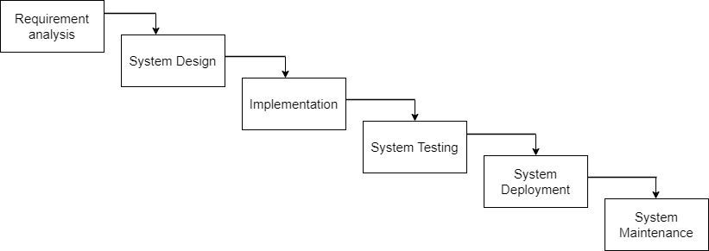
Waterfall Model
(Source: Software Engineering KEC Revised Edition)

Slide 8
Use Case-Diagram
Depicts two actors, User/Student, and Admin, represented by the stick figure.
Users/Students: Register, log in, browse notes/ questions, download, provide feedback, and log out.
Admin: Log in, manage the course resources, manage comments, and log out.

Slide 9
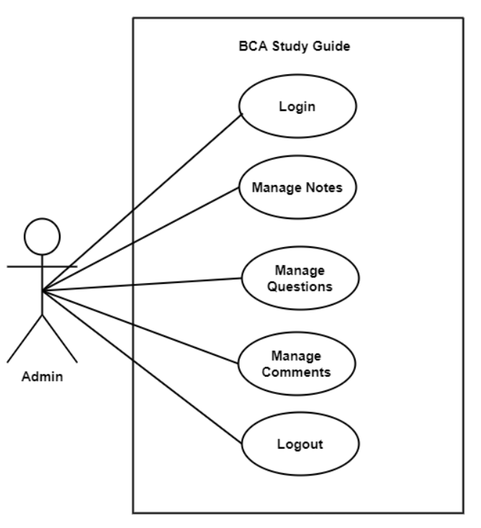
Use Case-Diagram for Admin

Slide 10
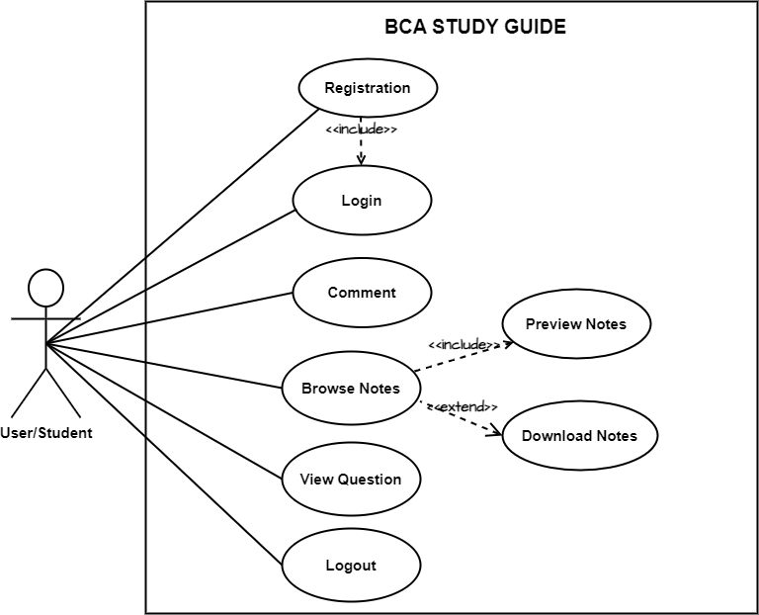
Use Case-Diagram for User

Slide 11
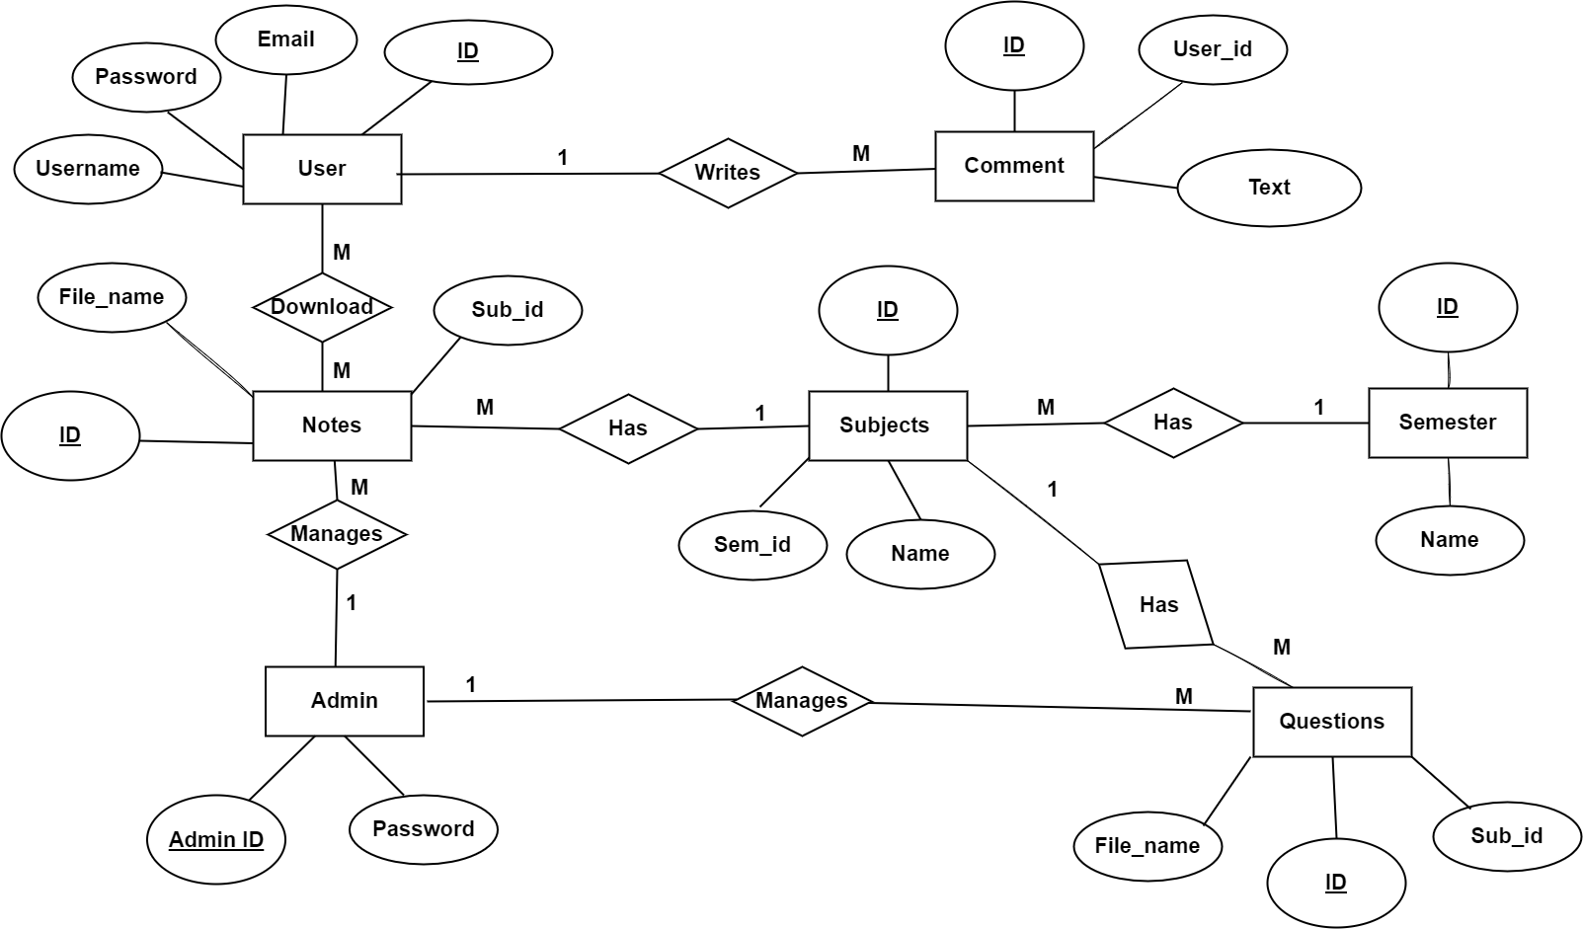
System Design (ER-Diagram)

Slide 12
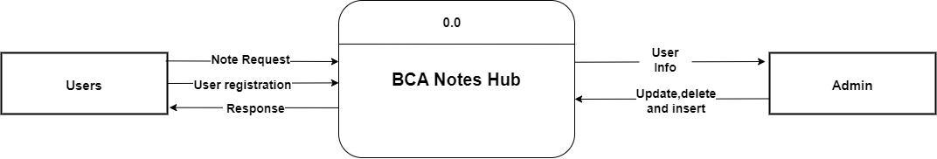
System Design (Level 0 DFD)

Slide 13
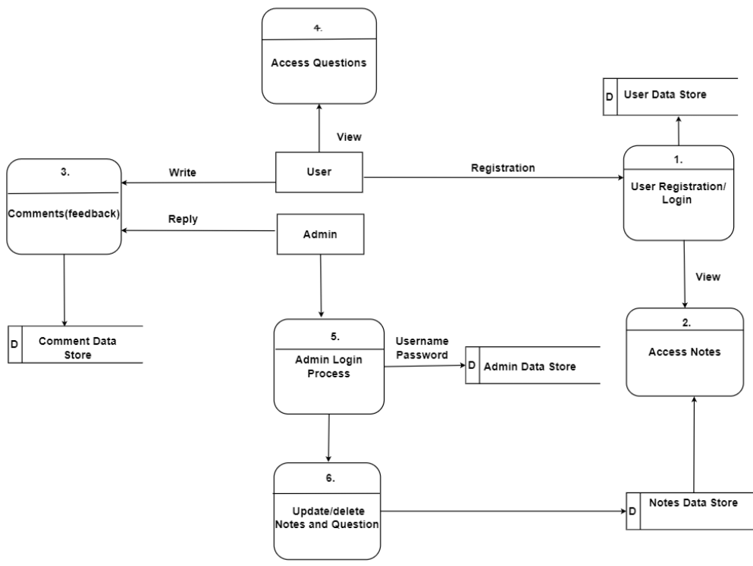
System Design (Level 1 DFD)

Slide 14
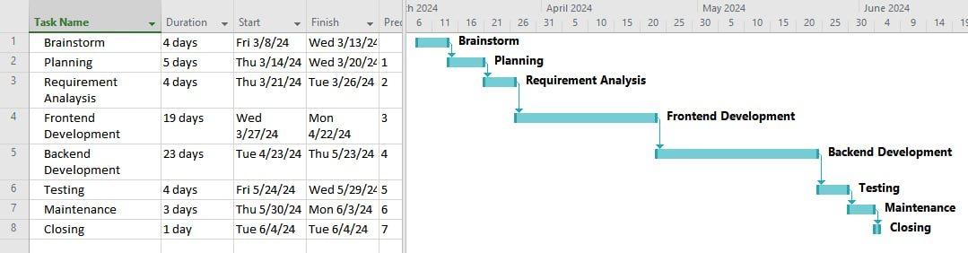
Gantt Chart

Slide 15

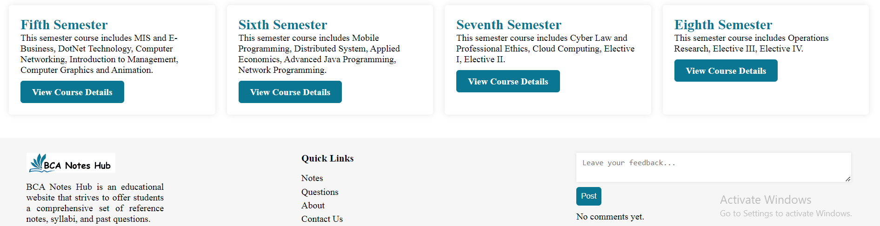
Appendices

Slide 16
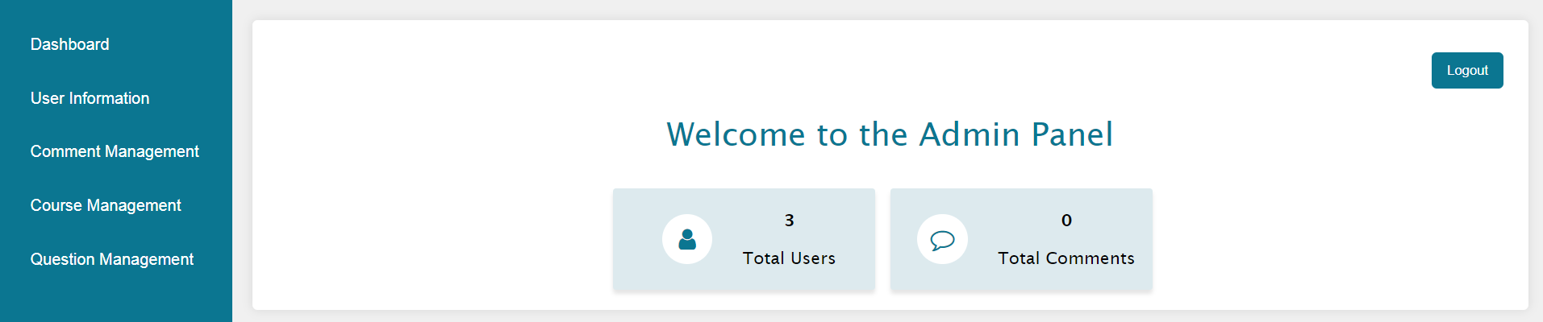
Admin Dashboard

Slide 17
Conclusion
The development of the website marks a substantial milestone in establishing a centralized platform.
Fulfills all the predefine objectives and meets the minimal expectations of any users.
Front-end design developed using HTML, CSS, and JS provides an intuitive and responsive design.
Back-end development executed through PHP and MySQL ensures the proper execution of logic.
Implements essential features such as user and admin authentication, feedback system, and notes management.

Slide 18
References
[1] | J. C. Elizabeth Moore Stacy, "Note-taking and Handouts in The Digital Age," American Journal of Pharmaceutical Education, vol. 79, no. 7, 2015.
[2] | R. Malani, Public digital note-taking in lectures, University of California, San Diego , 2009.
[3] | G. B. H. T. M. J. Jennifer Pearson, "The Digital Reading Desk: A lightweight approach to digital note-taking," Interacting with Computers, vol. 24, no. 5, pp. 327-338, 2012.
[4] | A. E. F. &. S. Titsworth, "The impact of digital distraction on lecture note taking and student learning," Instructional Science, vol. 48, pp. 495-524, 2020.
[5] | A. B. a. K. Koedinger, "Pasting and Encoding: Note-Taking in Online Courses," IEEE, 2006.
[6] | K. Beck, "Note Taking Effectiveness in the Modern Classroom," The Compass, vol. 1, no. 1, 2014.

Slide 19
DEMO SESSION

Slide 20


